Slide 1
Research Data Management Support – June 2014
Valerie McCutcheon, Research Information Manager
Notes:
GU work and demo of registry

Slide 2
What help is available?
Customised data management planning tool
Data registry
Data storage – funder, third party, University
IT Support
Training
Notes:
How can we help when we are not sure ourselves
EPSRC survey galvanised decision
1

Slide 3
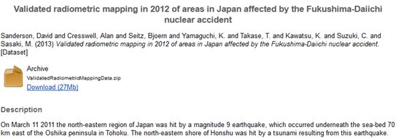
Data Registry Live January 2013
Notes:
2

Slide 4
Generation of robust Digital Object
Identifier Built In to Software
Glasgow DataCite format:
‘10.XXXX/gla.researchdata.2013.29’
Example from UKDA:
http://dx.doi.org/10.5255/UKDA-SN-7106-1
Notes:
3

Slide 5
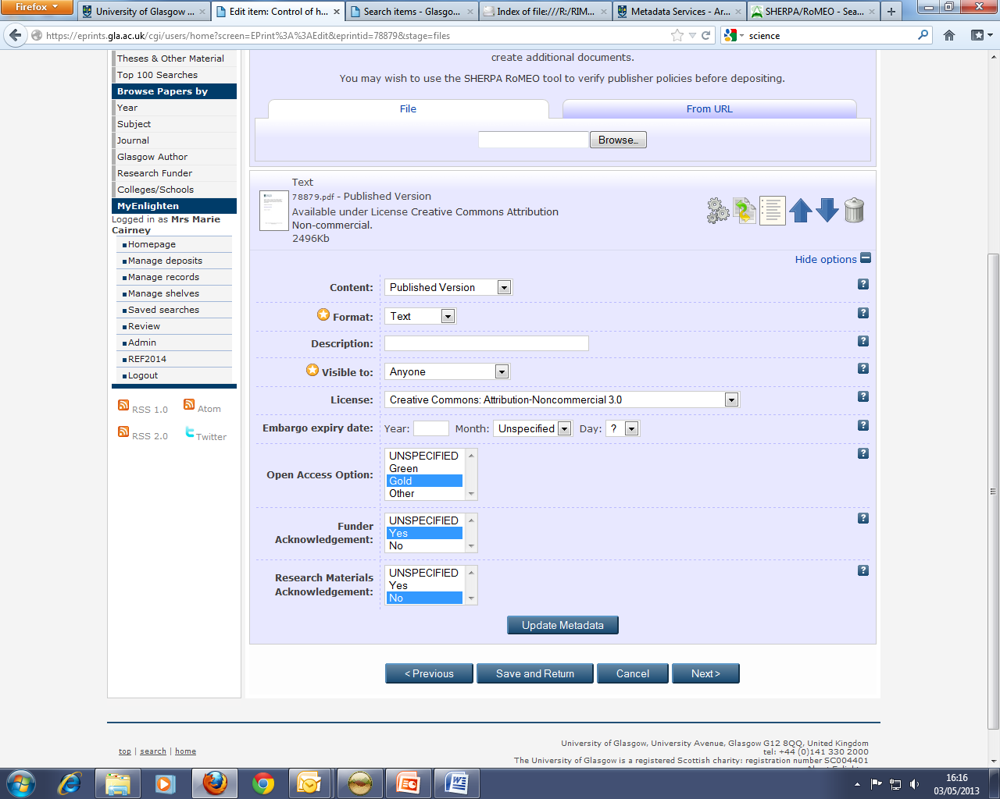
Notes:
This is a back office screen used by the publications repository (Enlighten) team and does not show publicly. Encouraging inclusion of dataset information in papers and checking compliance. It allows us to report to RCUK.
There is a consultation out for V4OA http://v4oa.net/2013/10/02/v4oa-public-consultation-paper-released/
The outputs from this consultation, along with inputs from the RCUK guidance, will be fed into work being led by CASRAI http://casrai.org/ to document agreement on integrated OA reporting standards and publish that agreement to the online dictionary for research administration data standards (http://dictionary.casrai.org). See blog post http://casrai.org/about/announcements/casrai-uk-working-group-to-advance-integrated-standards-for-open-accessThe objective is a single online registry of such administrative standards in order to simplify implementation and interoperability in common research-supporting software and across organizational, discipline and national boundaries.

Slide 6


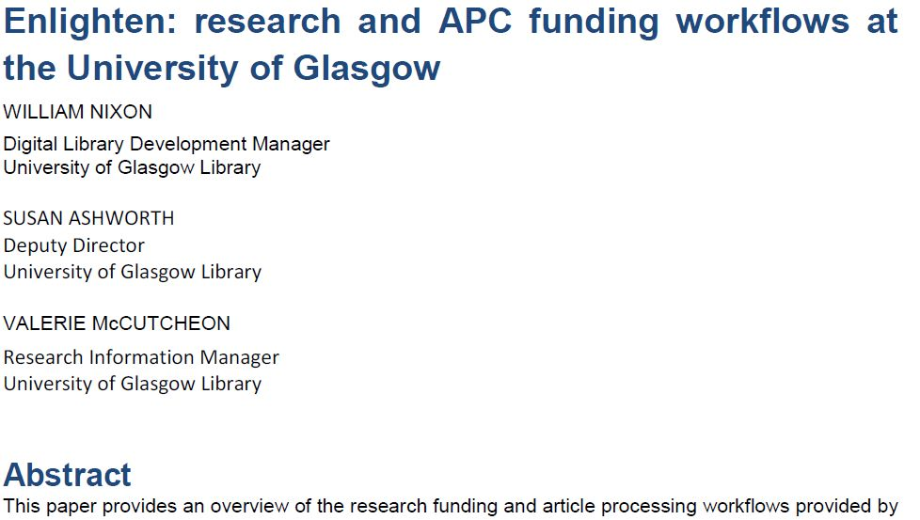

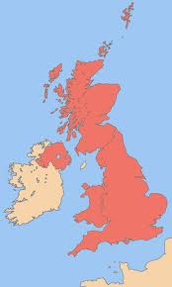

Open Access to Datasets
Your Research Paper
http://researchdata.gla.ac.uk/
Notes:
5

Slide 7

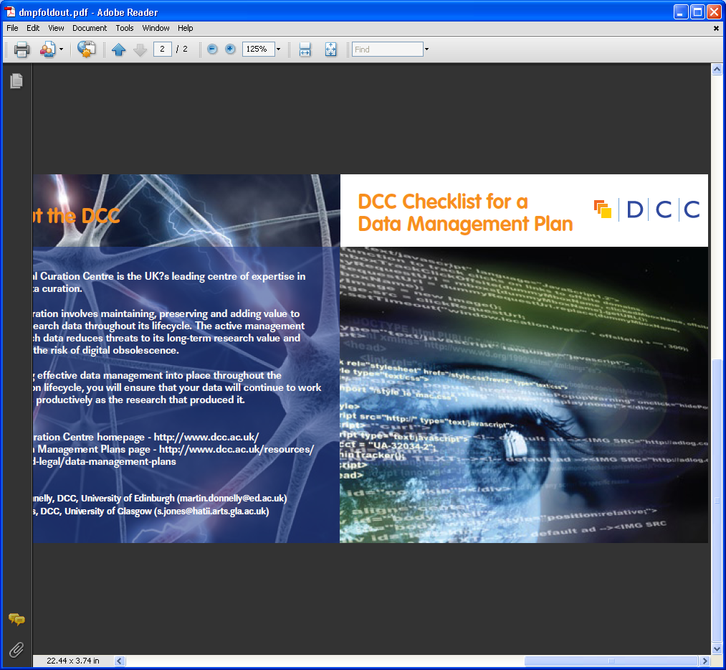

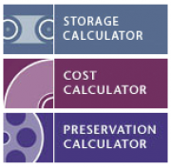

Integrating Data Management
in Research Process
https://dmponline.dcc.ac.uk/
Notes:
DMP plans link to grants team for costing and advising to do, to system to capture estimates of space required

Slide 8
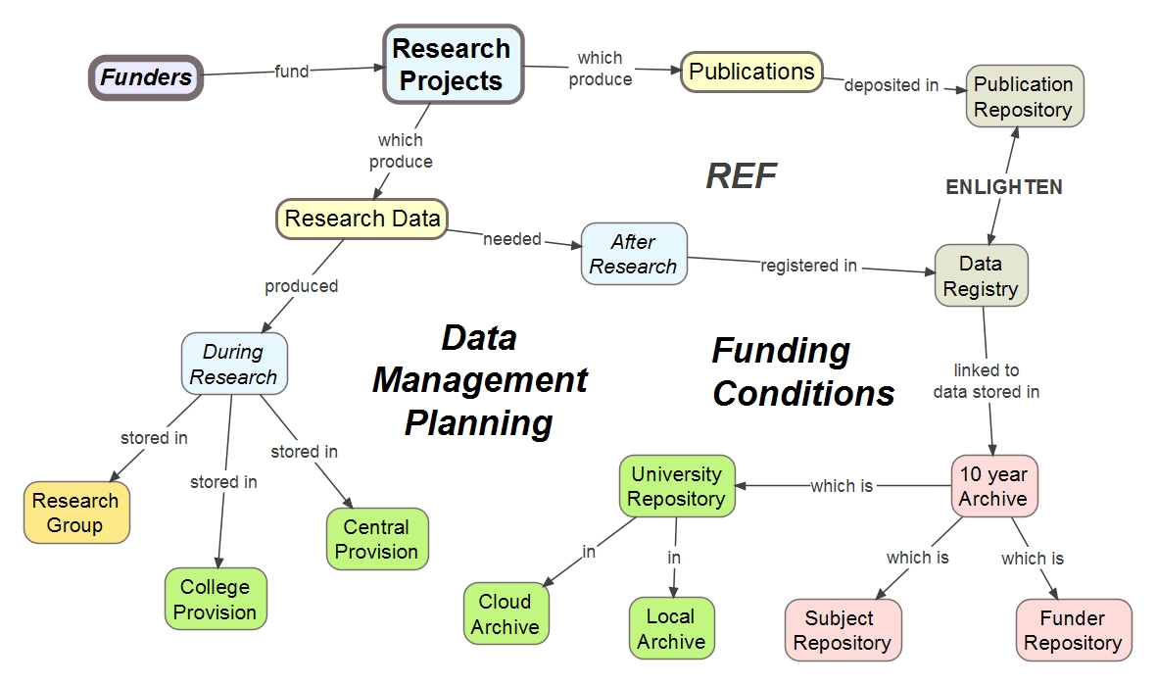
Where does the data fit into the bigger picture?

Slide 9
Where does the data fit into the bigger picture?

Slide 10


But....
DataCite Workshop 13th June http://t.co/pCz0BjTotx
Notes:
Limited User Engagement/Advocacy
No DOI’s minted so far
Temporary server – await stable numbers.
No demand….and don’t want to drive demand till we have a stable offering….
Unsure how to sell – hope to get some pointers at the forthcoming DataCite workshop.

Slide 11

What’s Next?
Clarifying requirements
Allocating resources – thanks EPSRC!
National/international registries
Harvesting metadata from publications
Linking to publications
What do you need?
Notes:
EPSRC survey galvanised decision
10

